Slide 1
Online Shopping Project
Nosente Goll, Marley Curtis & Noor Baakza

Slide 2
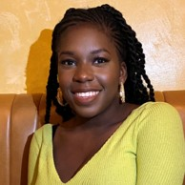
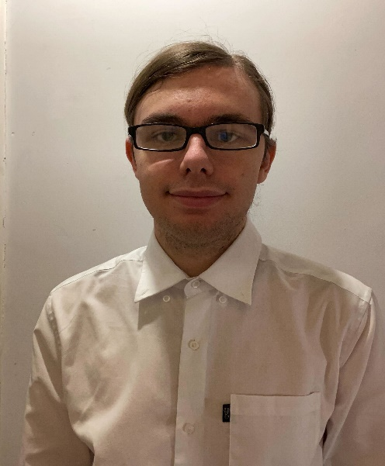
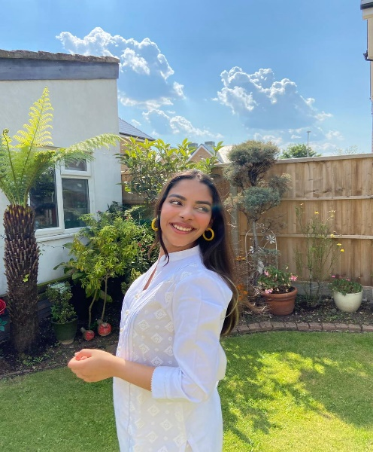
Meet the Team
Nosente Goll
Scrum Master
Marley Curtis
Back End Developer
Noor Baakza
Front End Developer

Slide 3
Purpose
To create an online shopping website and be able to have a profile that can checkout items
Notes:
The purpose of our project was to create a online shopping website, where the user is able to create a account and login in order to order the items that they would like and check them out.

Slide 4
Requirements
Registration
Login
Profile Page
Products
Basket
Proceed to checkout

Slide 5
LIFE CYCLE
Scrum Meetings
Roles and Tasks
Database Development
Presentation Planning
Sprint Lengths
Sprint lengths were a couple of hours
Road Blocks
Limitations and Extenuating circumstances

Slide 6
Development Tools
Front End
JavaScript
CSS
Back End
Java
Database
MySQL
PHP admin
Spring
JPA
Junit Testing
Bootstrap
HTML

Slide 7
Back End Structure
The back end is organised using the MVC (Model, View and Controller) structure.
Repositories are used to access the database content.
Services is where the business logic for each entity takes place.

Slide 8
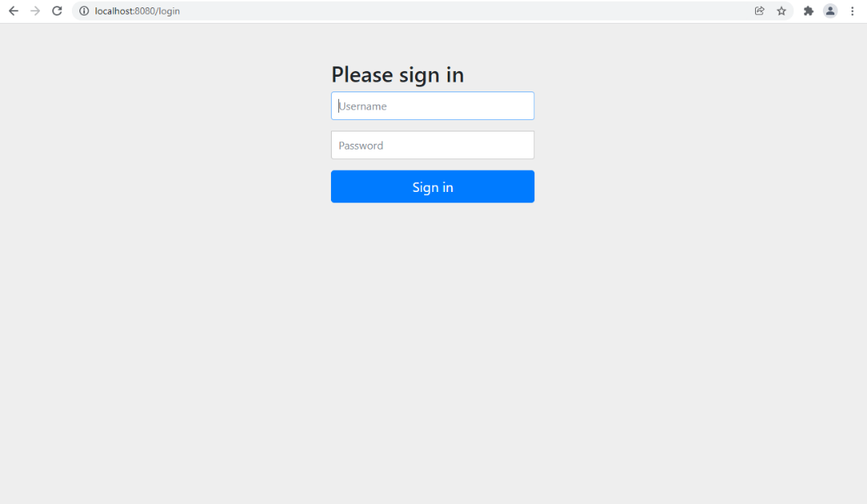
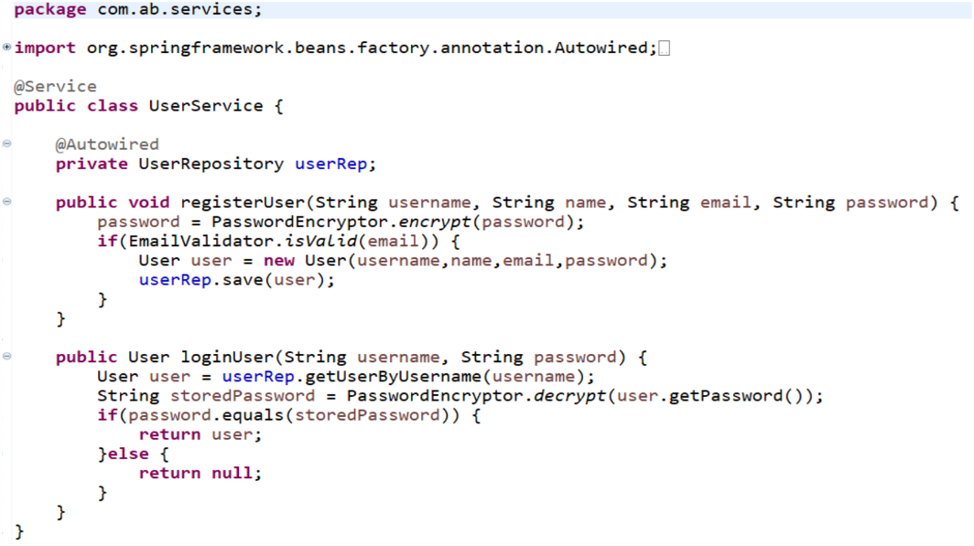
Development
Front end
Back end

Slide 9
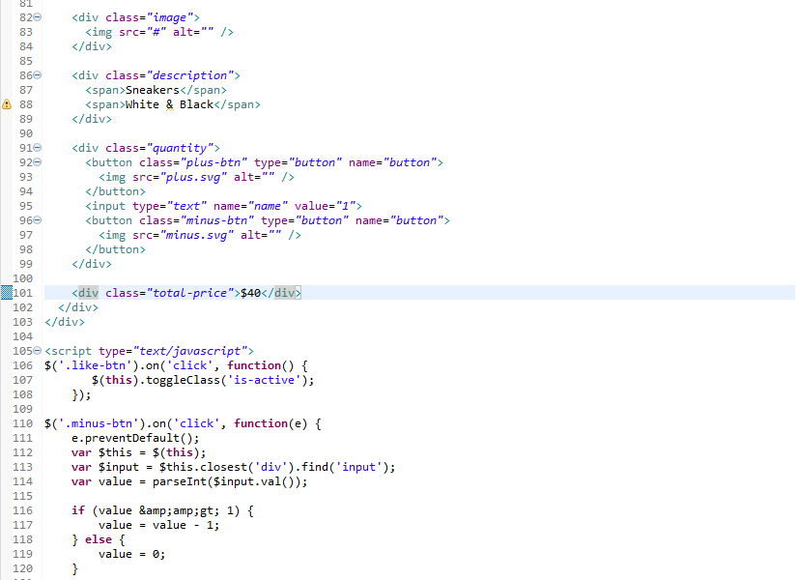
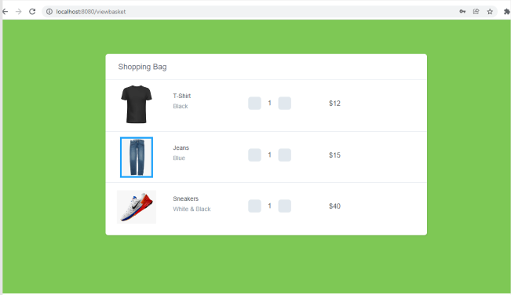
Development
Front end
Back end

Slide 10
Improvements...

Slide 11
Any questions?

Slide 12
Thanks for watching!

